Slide 1
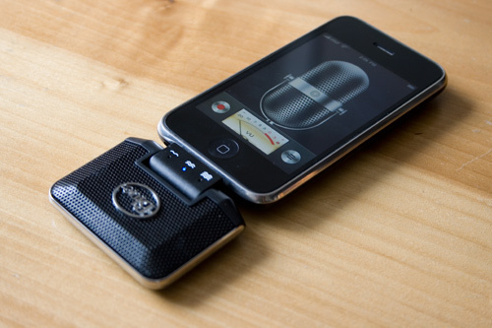
Audio Recordings in Family Court Proceedings
Image Copyright ©Allure Media 2009

Slide 2
⨂ Prohibition on the installation, use and maintenance of listening devices
⨂Prohibition on communication or publication of private conversations or recordings of activities

Slide 3
“[42] It is common ground between the parties that the recording of the private conversation between the parties by the father…is contrary to the provisions of the Surveillance Devices Act 2007 (NSW)…thus rendering the recordings illegal and the publishing of these recordings illegal.”
- Huffman v Gorman [2014] FamCA 150

Slide 4
Was there consent?
Was recording reasonably necessary for the protection of the lawful interests of that principal party?
Was communication or publication of private conversation reasonably necessary to prevent serious violence to persons or substantial damage to property?

Slide 5
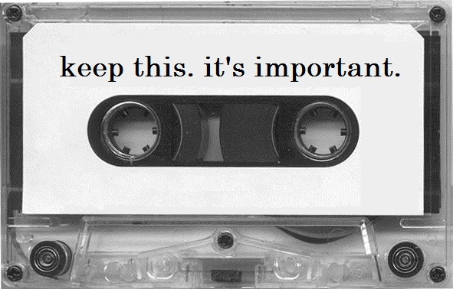
Image Copyright © ITLex Incorporated 2012
Important enough to warrant its admissibility?

Slide 6
Evidence Act 1995 (Cth)
Section 138 – Discretion to exclude improperly or illegally obtained evidence
Evidence that was obtained:
Improperly or in contravention of an Australian law; or
In consequence of an impropriety or a contravention of an Australian law;
Is not to be admitted unless the desirability of admitting the evidence outweighs the undesirability of admitting evidence that has been obtained in the way in which the evidence was obtained.

Slide 7
What is the probative value of the audio recording?
How important is the audio recording to the proceeding?
What is the nature of the audio recording and its relation to the nature of the subject-matter at hand?

Slide 8
Improper recording = impropriety or contravention of law
Family Court considerations regarding impropriety:
Gravity?
Deliberate or reckless?
Likely to be addressed in any other proceeding?
Difficulty of obtaining evidence without its occurrence?

Slide 9
“It is a matter which arises all too frequently, particularly in family law proceedings, and seems to have gathered support not only from parties to proceedings but also from legal representatives…It would seem, clearly, to be an evidence gathering exercise and one that, in my view at least…gives rise to serious concerns as to the behaviours of the party who records such evidence”.
- Federal Magistrate John Croker, as quoted in Alexander, H. (4 February 2013) ‘Gotcha tapes disliked by court’, Sydney Morning Herald.

Slide 10
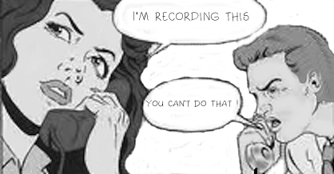
Image Copyright ©FIXYOURTHINKING 2004

